Slide 1








Slide 2


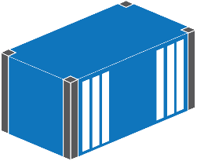

API
.yml

Slide 3
API
.yml

Slide 4


API
Ingress
Service
Secrets
Configuration
State

Slide 5
Pod
Deployment

Slide 6
apiVersion: apps/v1
kind: Deployment
metadata:
name: sleep
spec:
template:
spec:
containers:
- name: sleep
image: dak4dotnet/sleep

Slide 7
:8080
Service
ReplicaSet
Pod
Pod
Deployment

Slide 8
kind: Service
spec:
ports:
- port: 80
targetPort: 80
type: LoadBalancer
---
kind: Deployment
spec:
replicas: 2
template:
spec:
containers:
- image: dak4dotnet/signup-web-core:linux

Slide 9
:8080
:1433
Service
Service
ReplicaSet
ReplicaSet
Pod
Pod
Pod
Deployment
Deployment
ConfigMap
Secret
Secret
Volume

